Slide 1
Eden Isle Resilience and Flood Risk Reduction
June 20, 2023
Ignacio Harrouch, PE – CPRA
Glenn Ledet, PE – NSI

Slide 2
Eden Isle Resilience and Flood Risk Reduction
Pre-construction Services – Phase I
This proposed CPRA task order is associated with the PRE-CONSTRUCTION SERVICES FOR THE EDEN ISLE RESILIENCE AND FLOOD RISK REDUCTION PROJECT. The Phase I services will include the planning efforts for the Flood Risk Reduction and Resilience of the Eden Isle Community. These services will also include a conceptual 15% design for selected project features.
The professional engineering services will include project planning, project management, data gap analysis (including project background research and development of a data collection plan for optimization), optimization planning, preliminary design, (including project E&D and cost estimate refinement).
Tasks for subsequent phases for detailed engineering and design of the initial project feature (i.e. Phase II) for implementation will be further scoped, negotiated, and added to this task order through amendment requests based on the products and successful completion of prior phases.

Slide 3
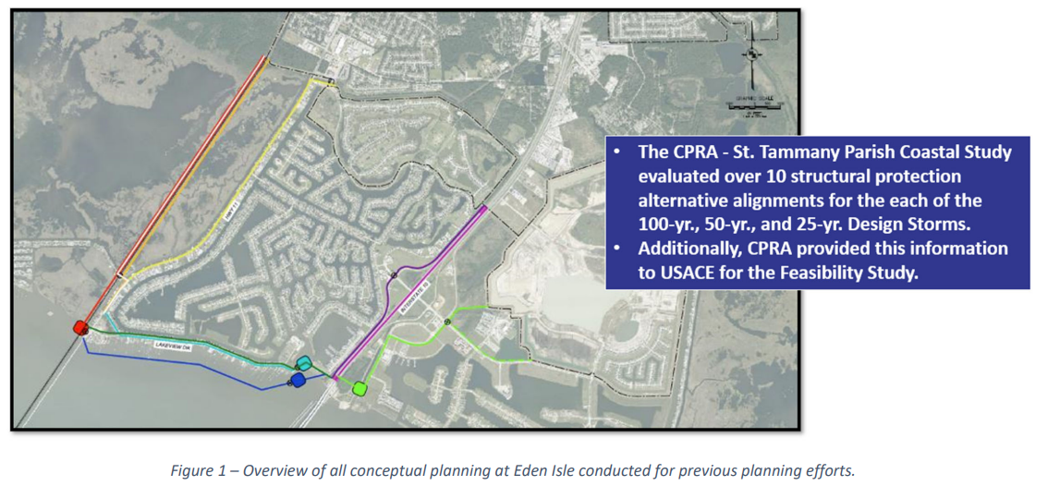
Eden Isle Resilience and Flood Risk Reduction

Slide 4
Eden Isle Resilience and Flood Risk Reduction
Phase I Tasks will include three primary tasks
1. Overall Conceptual Plan and Alignment recommendations for Eden Isle Resilience and Flood Risk Reduction – This task includes:
Review of Existing Data and Planning Efforts
Updated Alternatives Analysis (Design Elevation and Project Alignment Evaluation)
Updated Alternative Project Cost Estimates
Recommendation on Selected Alignment, Design Elevation, and Construction Phase Plan
2. Stakeholder Engagement Meetings with STPG and STLDCD

Slide 5
Eden Isle Resilience and Flood Risk Reduction
Phase I Tasks will include three primary tasks
3. Initial Project Feature Conceptual Design (15% Design)
Conceptual 15% Engineering and Design
15% Cost Estimate
15% Technical Memo

