Slide 1
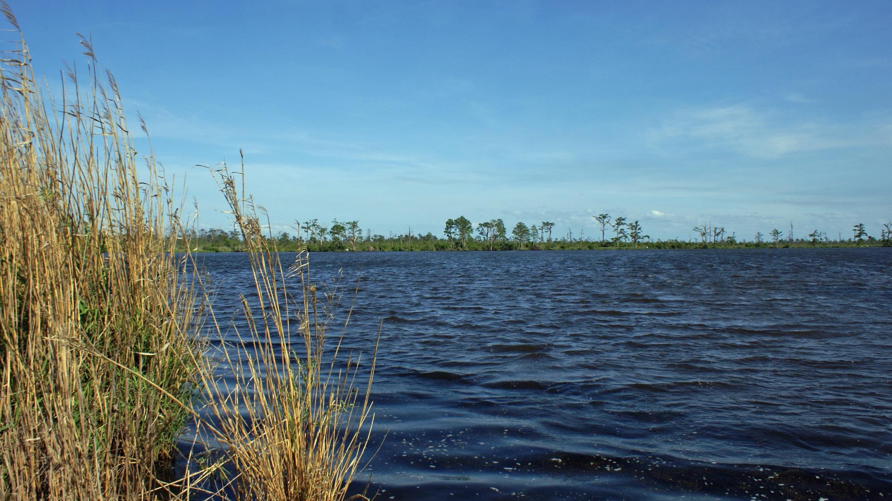


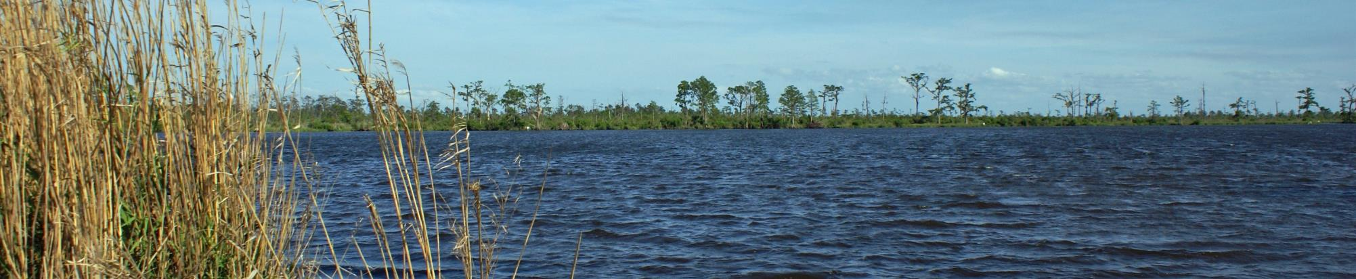
ST. TAMMANY COASTAL PROTECTION & RESTORATION
Project Committee Meeting March 2022

Slide 2
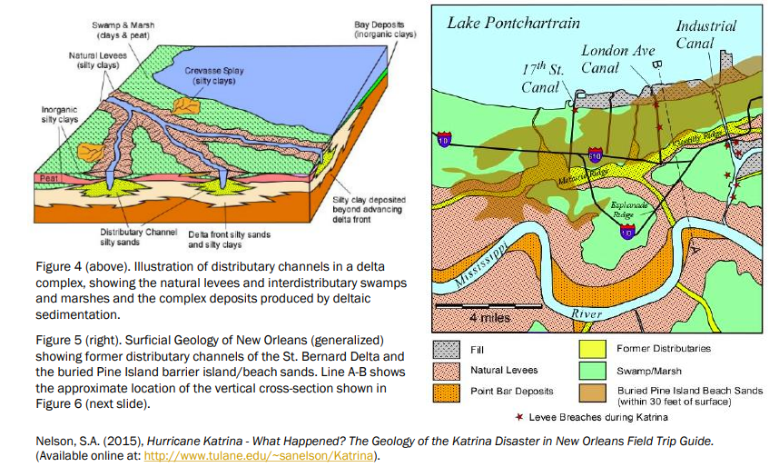
Louisiana Geology

Slide 3
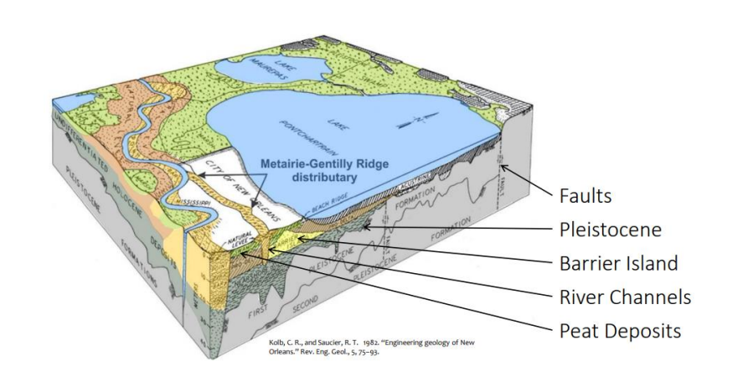
Louisiana Geology

Slide 4
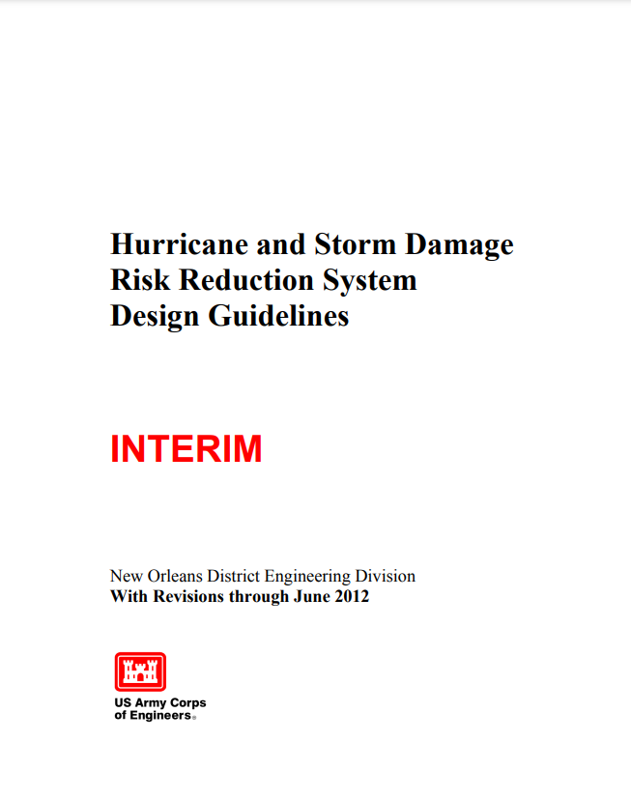
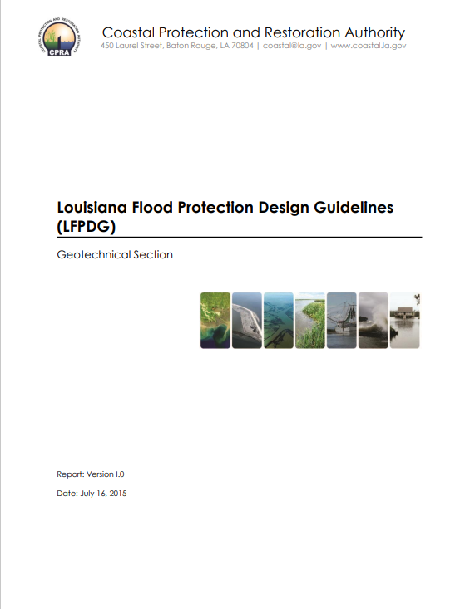
Geotechnical Engineering for Flood Risk Reduction Projects
USACE Federal - Hurricane and Storm Damage Risk Reduction System Design Guidelines (HSDRRSDG)
CPRA Non-federal – Louisiana Flood Protection Design Guidelines (LFPDG)
Notes:
Our team is local and has offices in Slidell and Mandeville.
A local presence ensures that our work is informed and coordinated with the issues, governance, and opportunities unique to St. Tammany Parish.

Slide 5
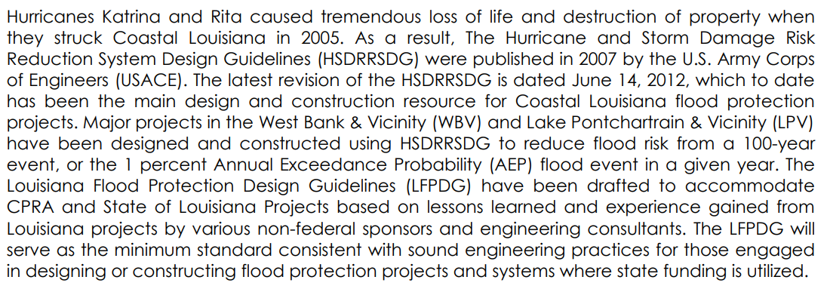
Geotechnical Engineering for Flood Risk Reduction Projects
Notes:
Our team is local and has offices in Slidell and Mandeville.
A local presence ensures that our work is informed and coordinated with the issues, governance, and opportunities unique to St. Tammany Parish.

Slide 6
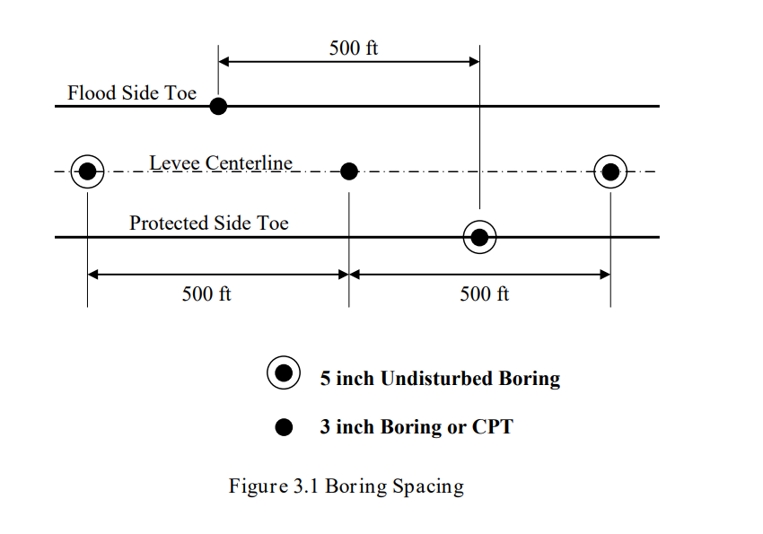

Geotechnical Data Collection Standards – USACE HSDRRS

Slide 7
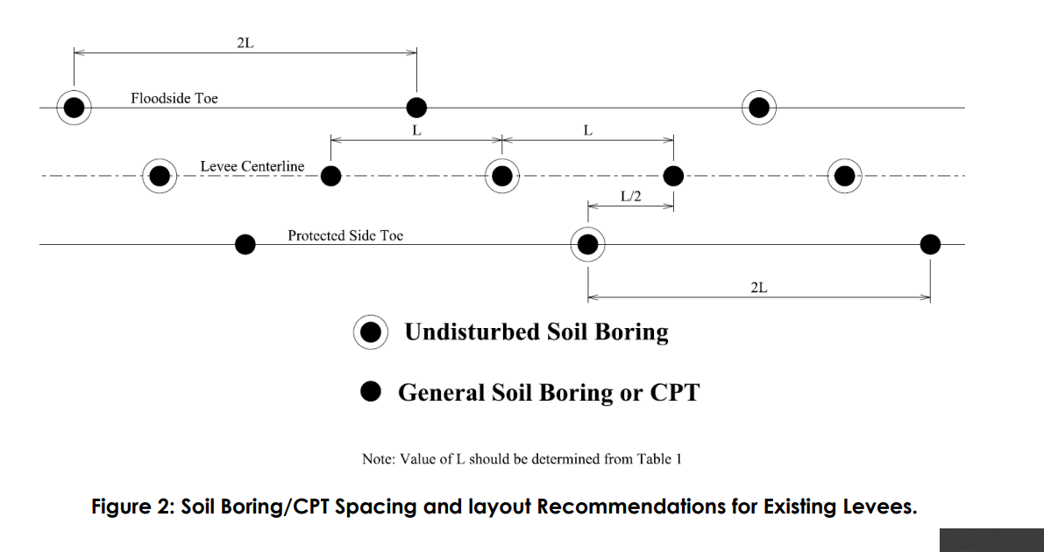
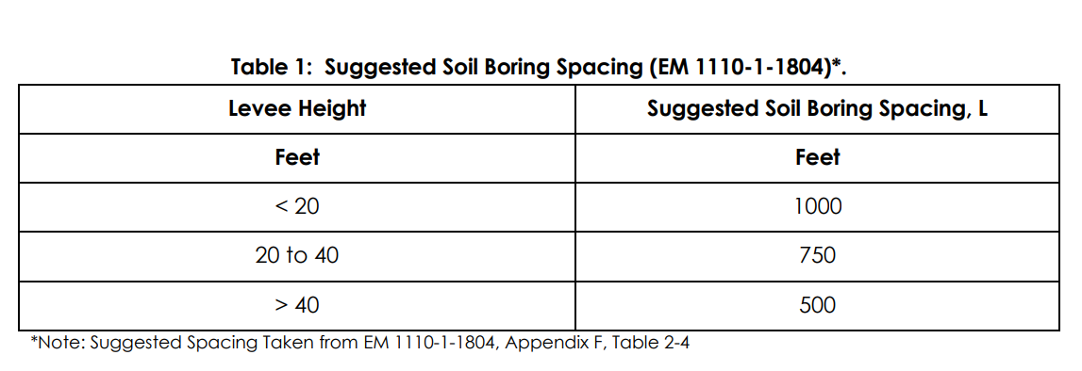
Geotechnical Data Collection Standards – CPRA LFPGDG

Slide 8
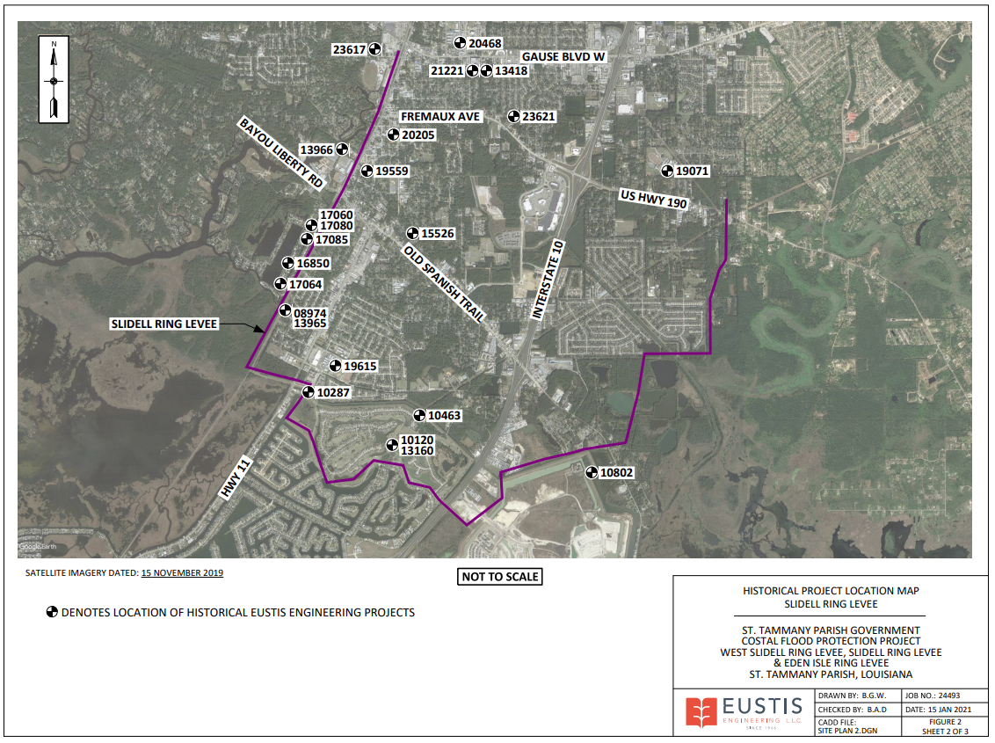
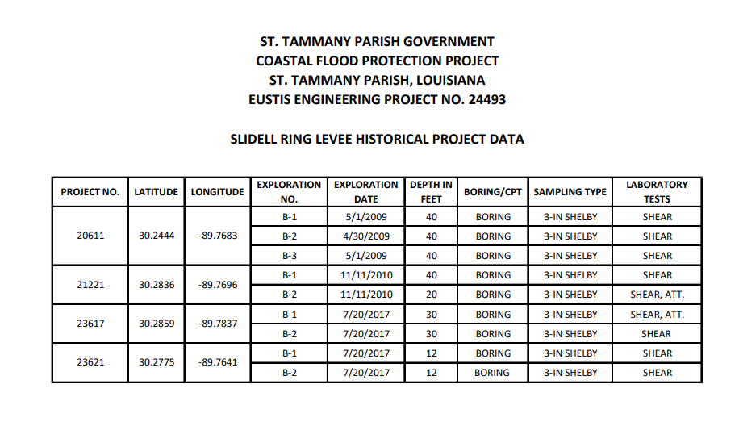
Geotechnical Data Collection Gap Analysis

Slide 9
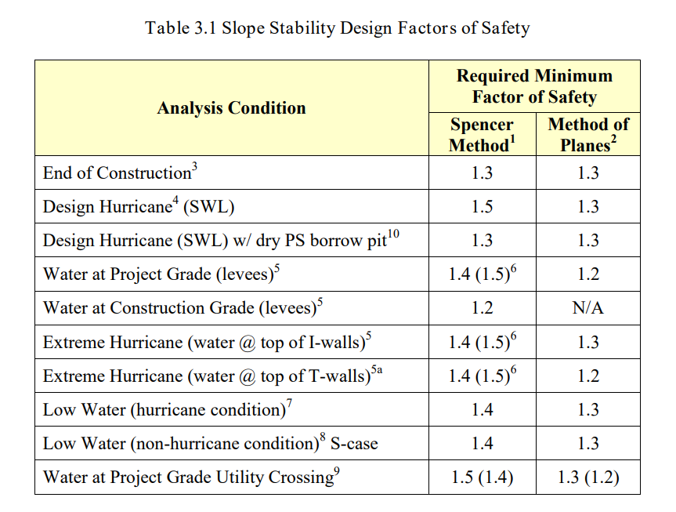
Geotechnical Factors of Safety Standards – USACE HSDRRS

Slide 10
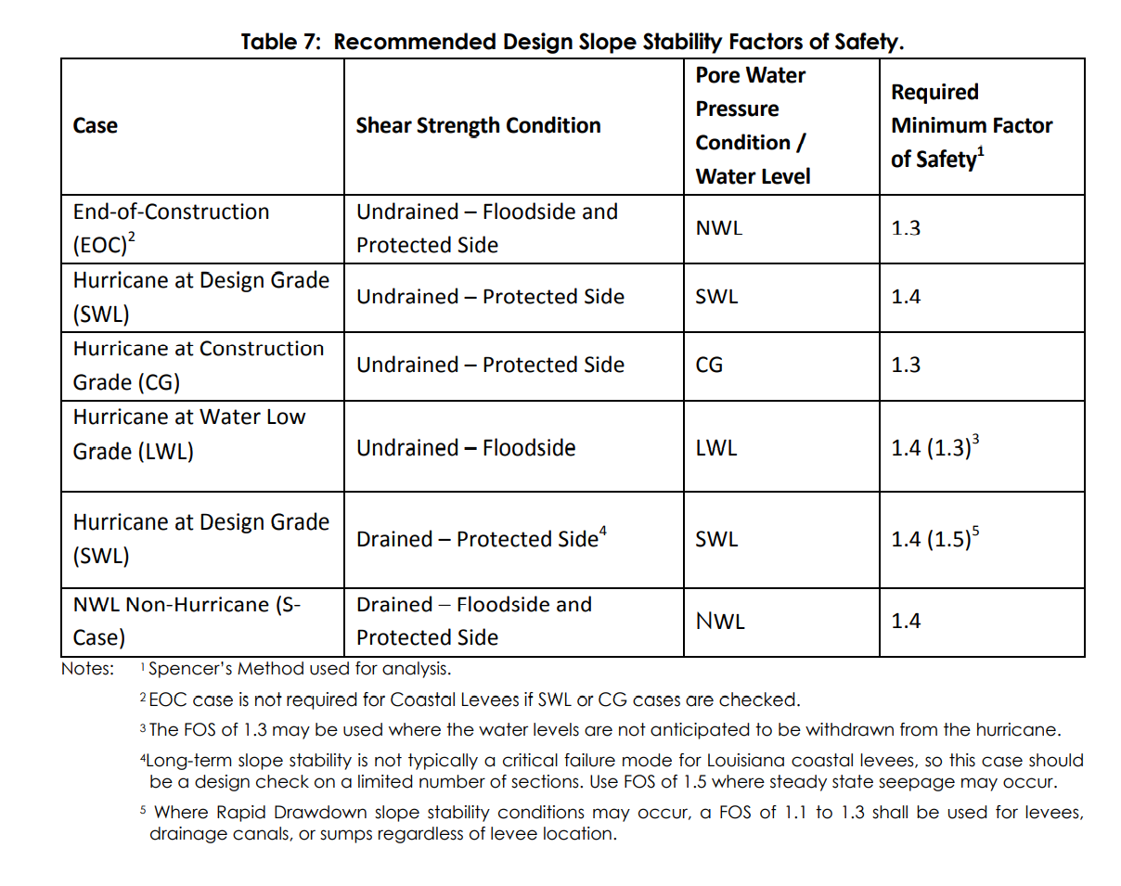
Geotechnical Factors of Safety Standards – CPRA LFPDG

