Slide 1
Turnover of Storm Hardened Gage at Mandeville
St. Tammany Levee Drainage and Conservation district
7/20/22

Slide 2
Storm-Hardened Gages: why did we build them?
Continuous Water Level measurements
Structure high and strong enough to survive storm surge
Data can be used in real time during storm to
Predict storm surge and flooding (guide hurricane response)
Make operational decisions (e.g., close flood gates)
Also used post-storm to evaluate performance of flood protection systems and to improve various models.

Slide 9
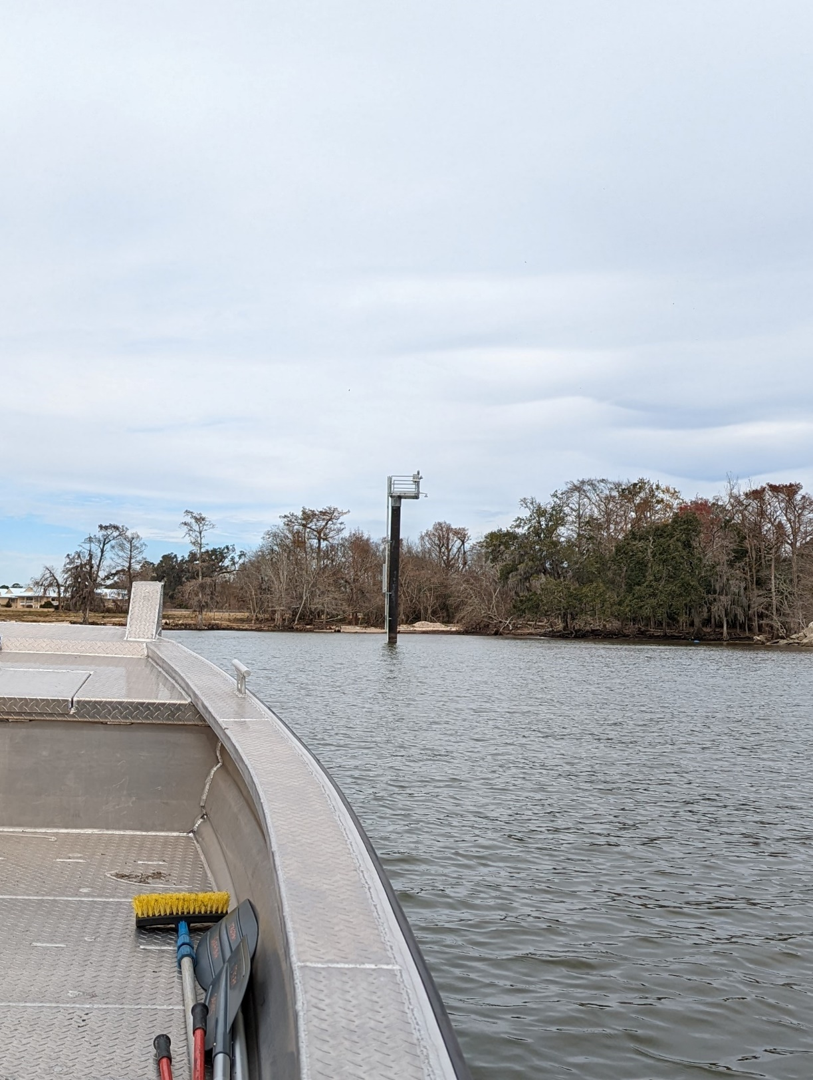

Slide 10
Turnover
USACE > CPRA (local sponsor) > Levee Districts
Levee District performs O&M for life of project
Usual Turnover process – simple turnover Letter from CPRA to levee district
The STLDCD Situation: given your special situation with no ability to pay for or perform the O&M directly, we need another option.
Solution: turn over to Parish and Levee district jointly via IGA; parish takes O&M until levee district is able. (timeline – month)

Slide 11
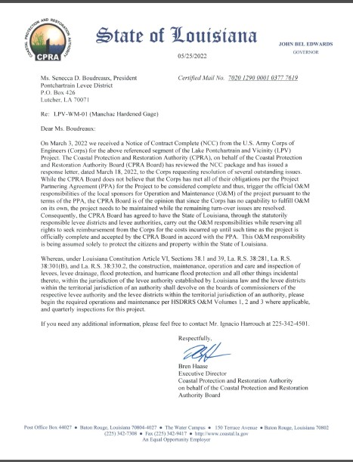

Slide 12
The Problem
Gages are in operation and need regular maintenance
Options:
Parish performs maintenance
CPRA performs maintenance (contractually longer process, so may not help in short term)
Other?

