Slide 1
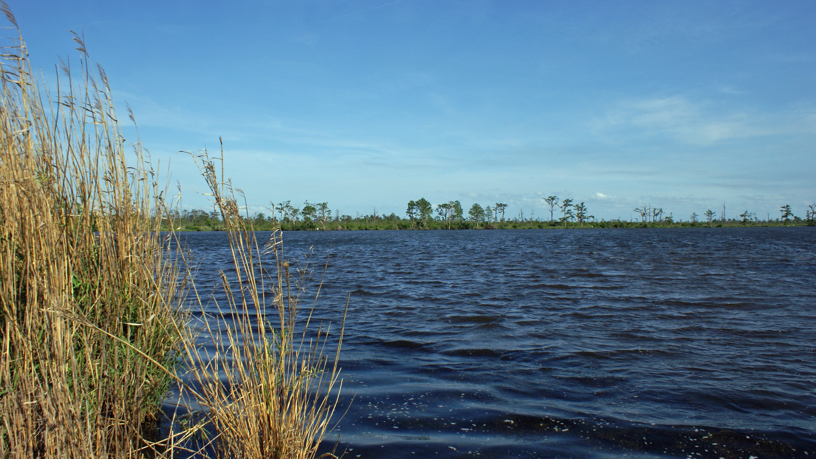


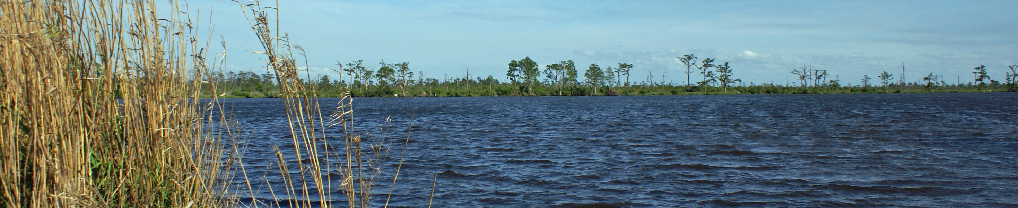
ST. TAMMANY COASTAL PROTECTION & RESTORATION

Slide 2
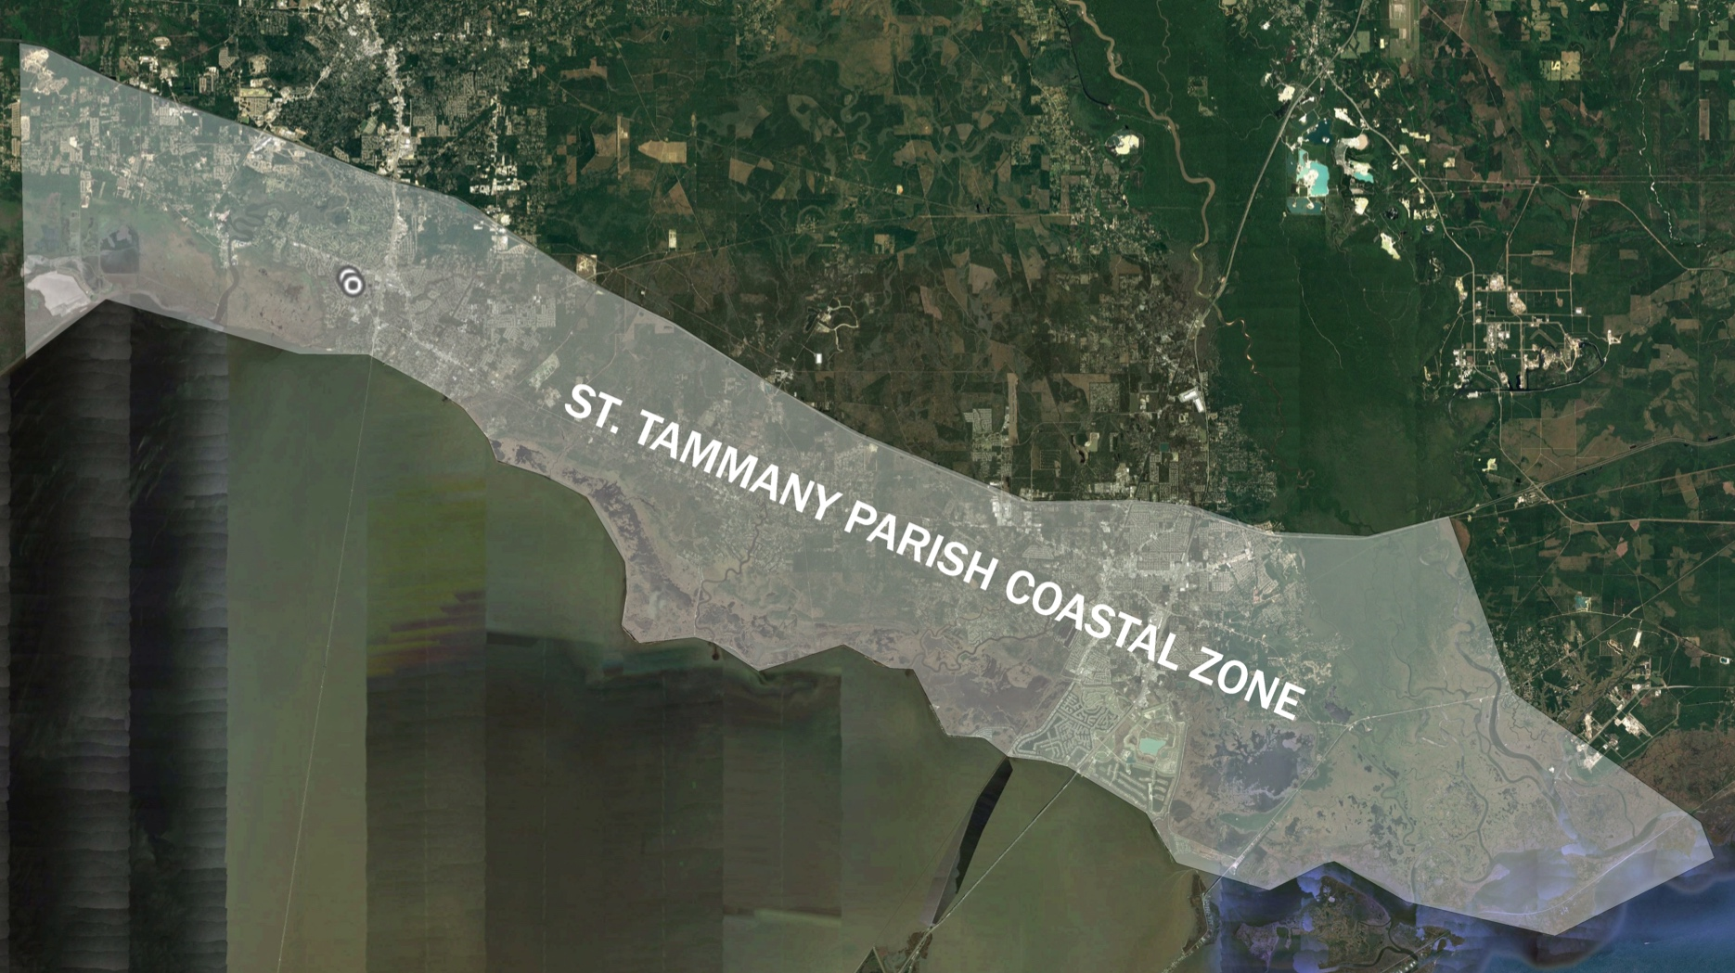
St. Tammany Levee, Drainage and Conservation District
Created during the 2014 State Legislative Session
The 9-member Board is populated by gubernatorial appointments from various communities throughout St. Tammany Parish
STLDCD is a political subdivision of the State and has the primary duty to “…establish, construct, operate, or maintain flood control works related to hurricane protection, tidewater flooding, saltwater intrusion, and conservation.”
Current Jurisdictional Area
St Tammany Coastal Zone
Area South of Interstate 12
Mandeville
Slidell
Notes:
Our team is local and has offices in Slidell and Mandeville.
A local presence ensures that our work is informed and coordinated with the issues, governance, and opportunities unique to St. Tammany Parish.

Slide 3
St. Tammany Parish Coastal Study

Slide 4
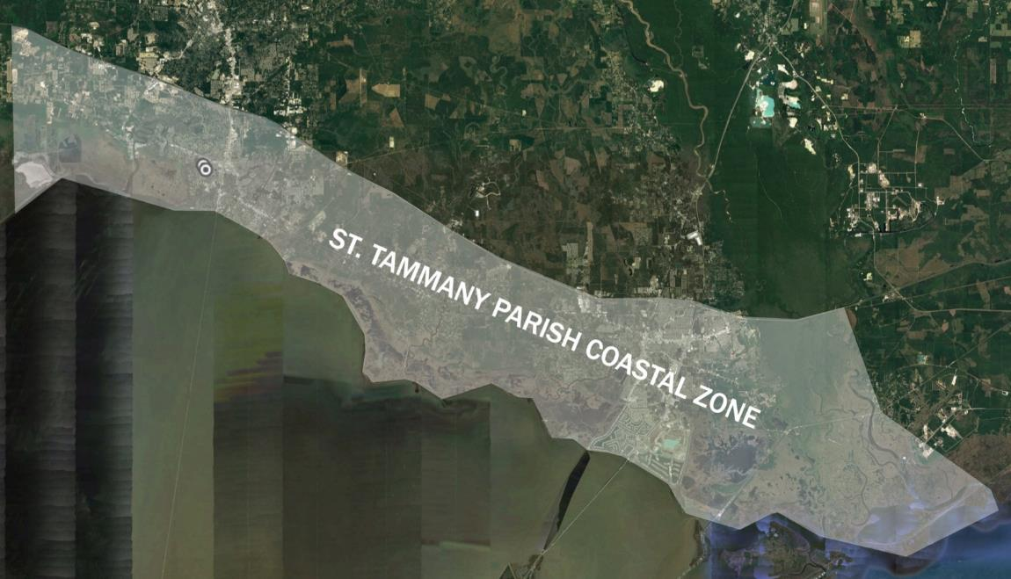

St. Tammany Parish Coastal Study
A collaborative effort between STPG and STLDCD, made possible with funding from CPRA.
Mandeville
Project Area
Area South of Interstate 12
Scope of Project
Coastal Storm Risk Reduction
Coastal Resilience
Slidell
Notes:
Our team is local and has offices in Slidell and Mandeville.
A local presence ensures that our work is informed and coordinated with the issues, governance, and opportunities unique to St. Tammany Parish.

Slide 5
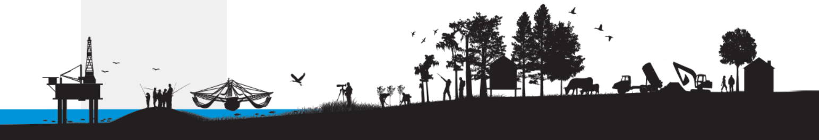
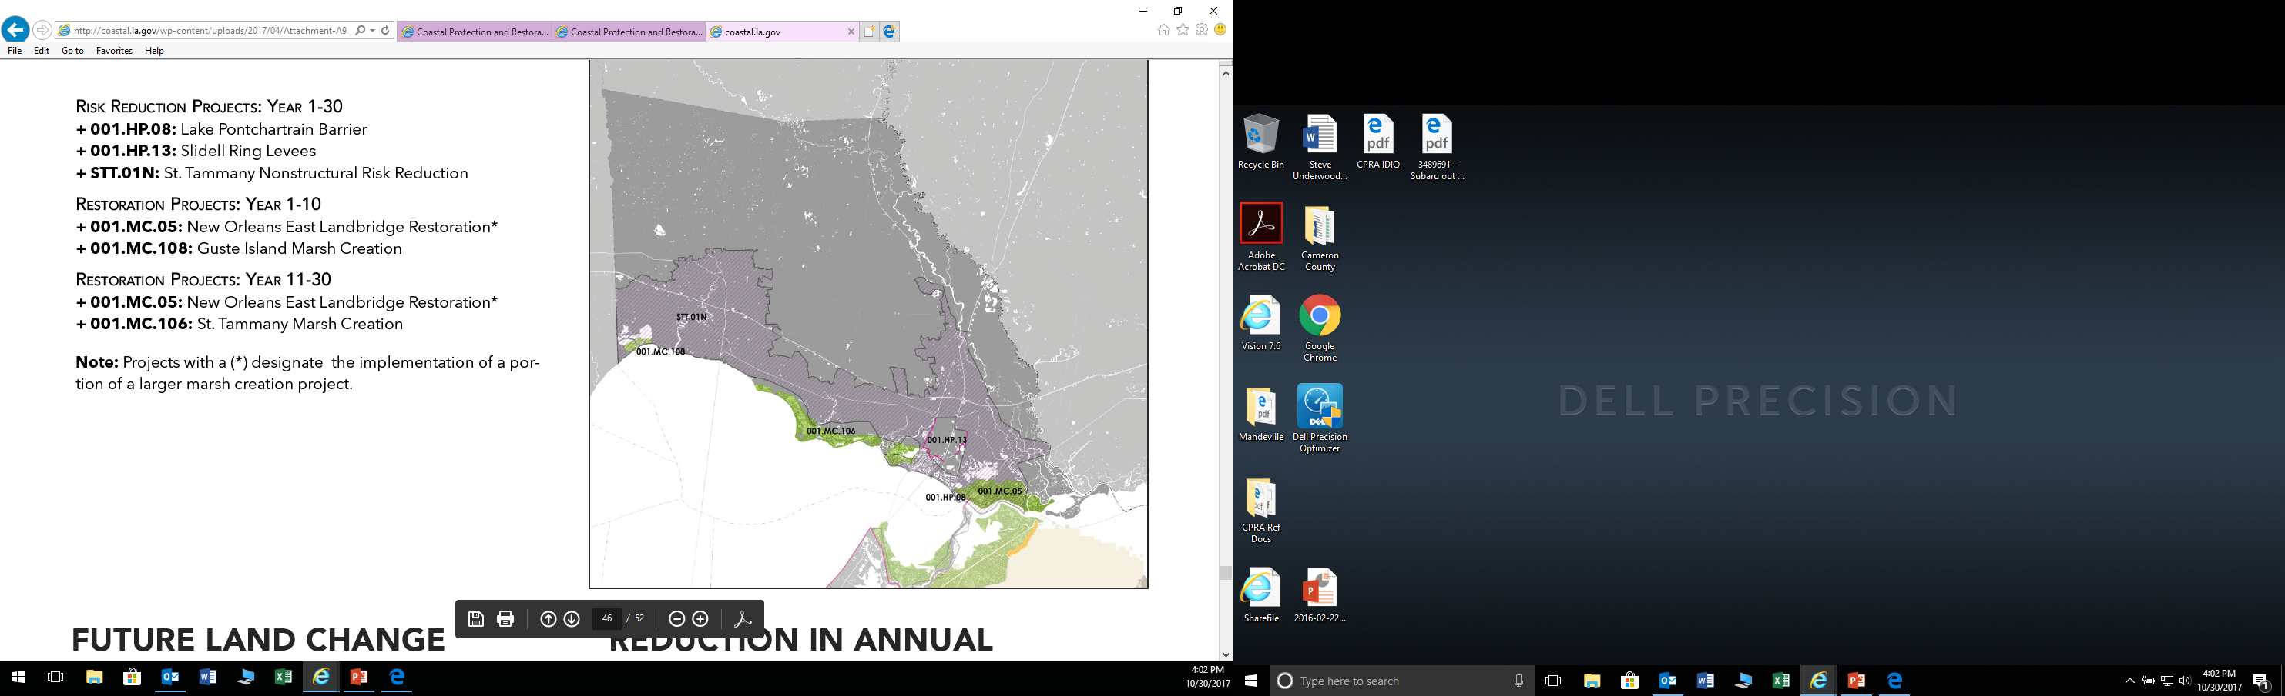
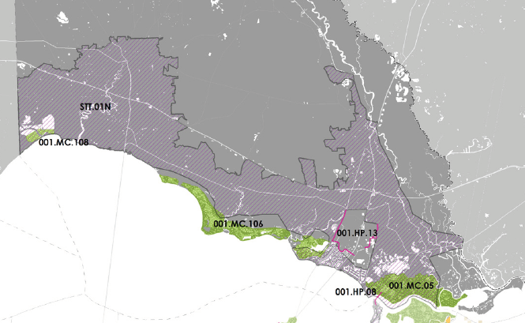
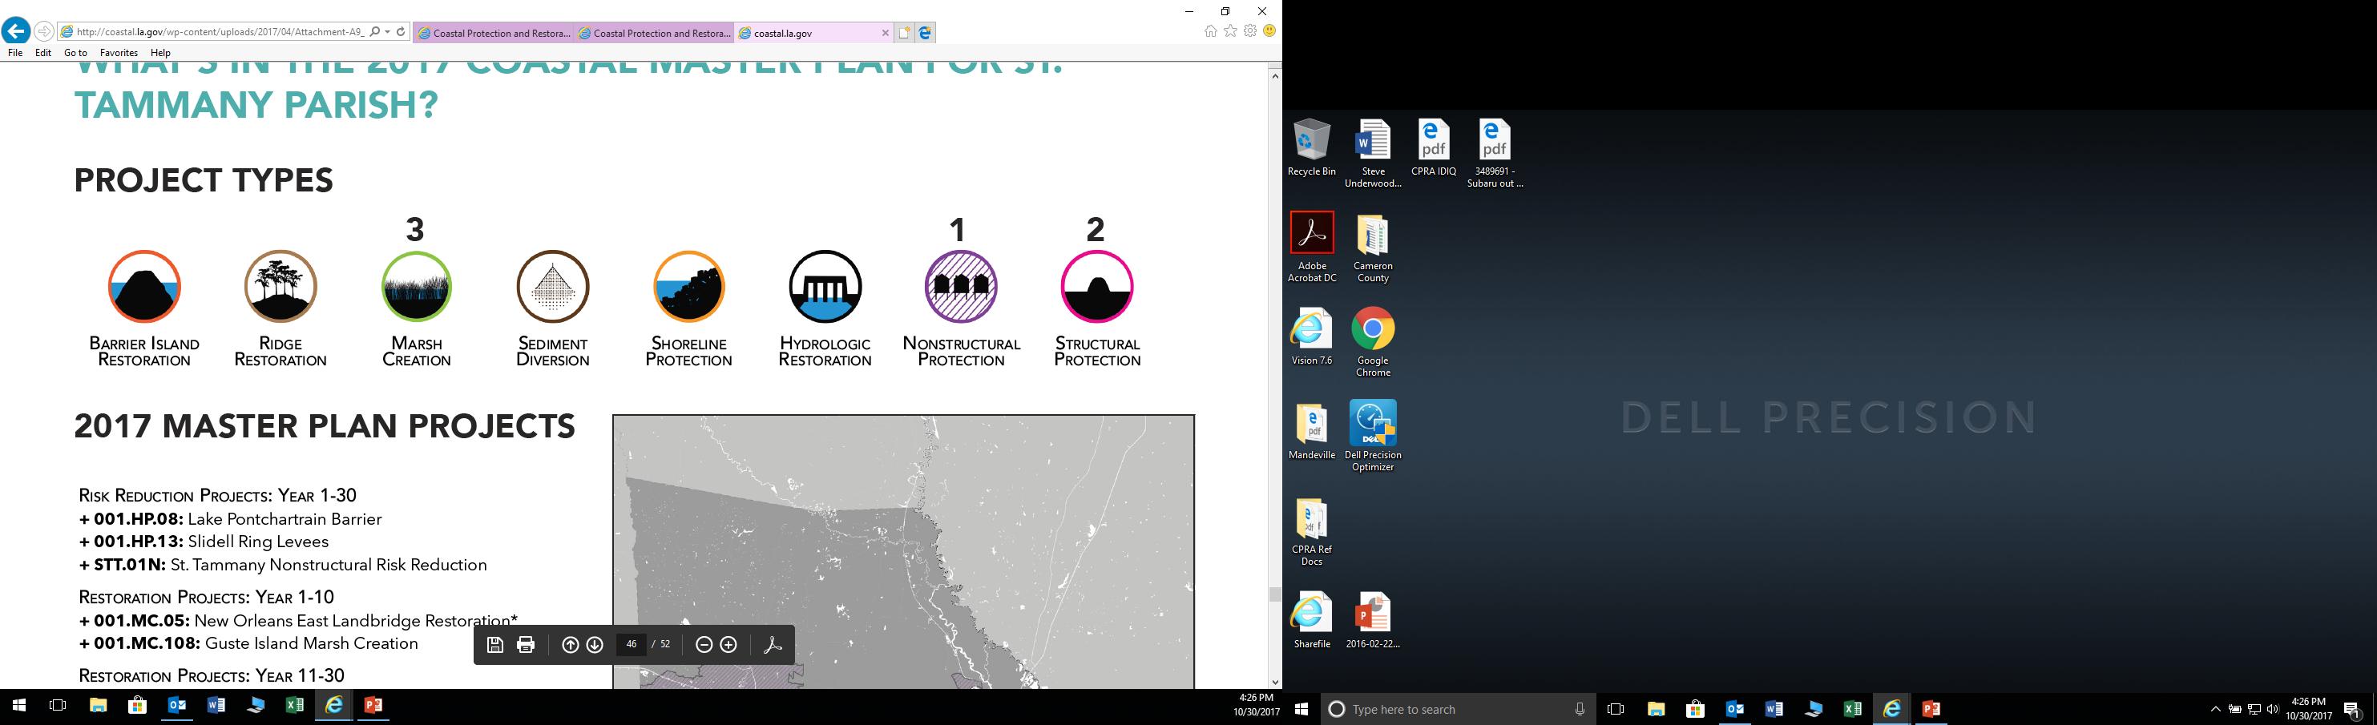
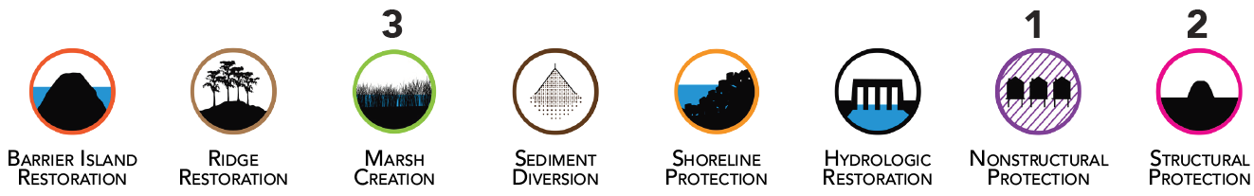
2017 CPRA Master Plan Risk Reduction Projects
Project Types
Notes:
Current Master Plan projects for St. Tammany. Whatever is finalized by the Parish, we want to make sure projects are consistent with the State’s Master Plan.
We note that there are currently no structural protection projects proposed for many areas of the Parish, and we will focus on this gap in protection. NS would look at structural alternatives throughout the parish.

Slide 6
FLOOD RISK REDUCTION – STRUCTURAL

Slide 7
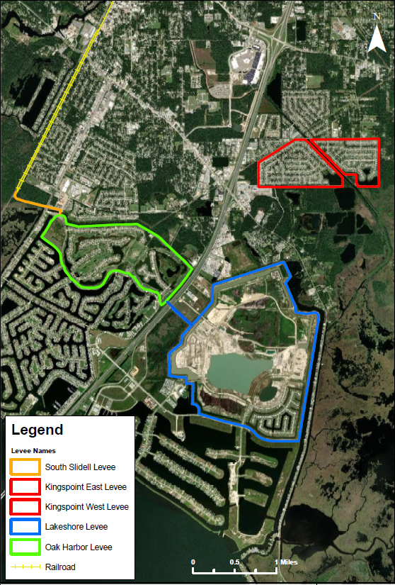
Existing Flood Risk Reduction Projects – Slidell
Notes:
The NS team has the ability to accelerate the project schedule by as much as 3 months compared to other teams. This is in part due to the fact that we have much of the data, the GIS work, and our team has intimate knowledge of the area. This gives us a strong basis of moving forward. In addition, some of our team assisted in the implementation of STP ArcGIS server application and the training of parish staff. Our Project Team is thoroughly familiar with the parish’s GIS system and operating procedures.
This saves the Levee Board and Parish time and money that can be used to further develop projects.
Added Value ??????
In addition to the RFQ required elements for the Inventory Report, the Project Team will include additional elements in its GIS—census data, land use and land change data, critical infrastructure, FEMA DFIRMs, watersheds, repetitive and severe repetitive loss data, DEM, LiDAR, aerial photography.
Tasks 1 & 2 and part 1 of Task 3 will be completed in 6 months.

Slide 8
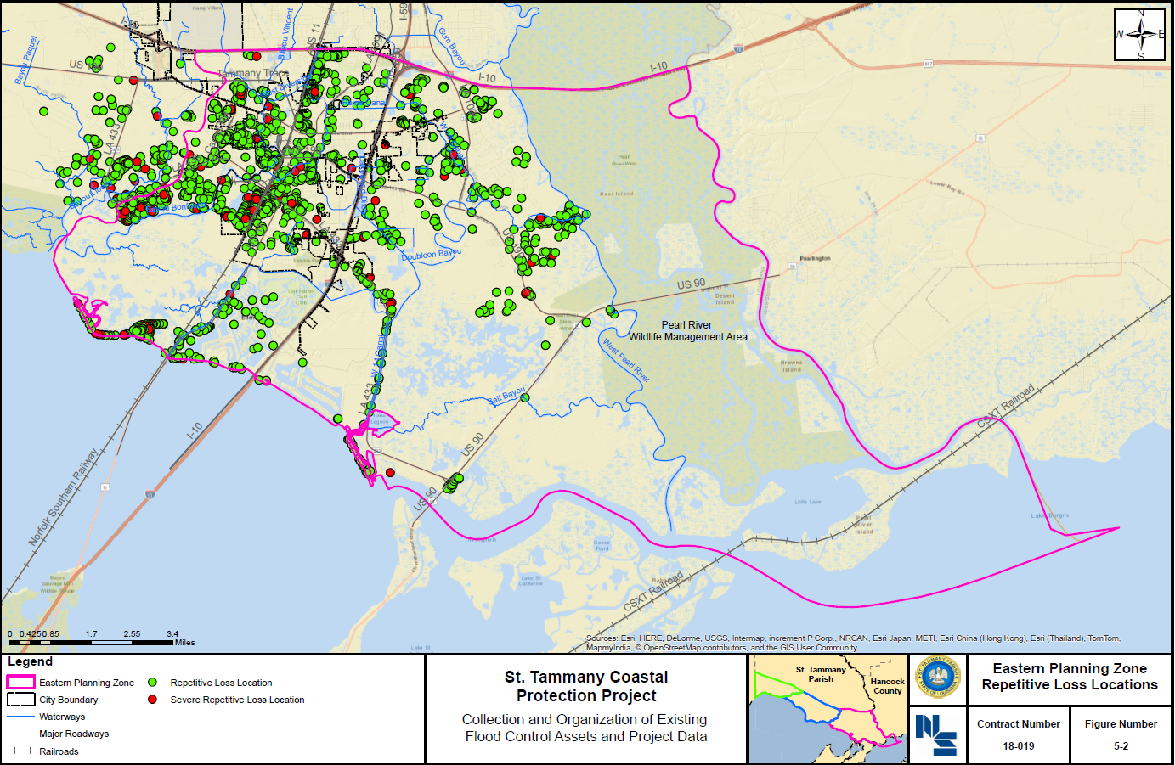
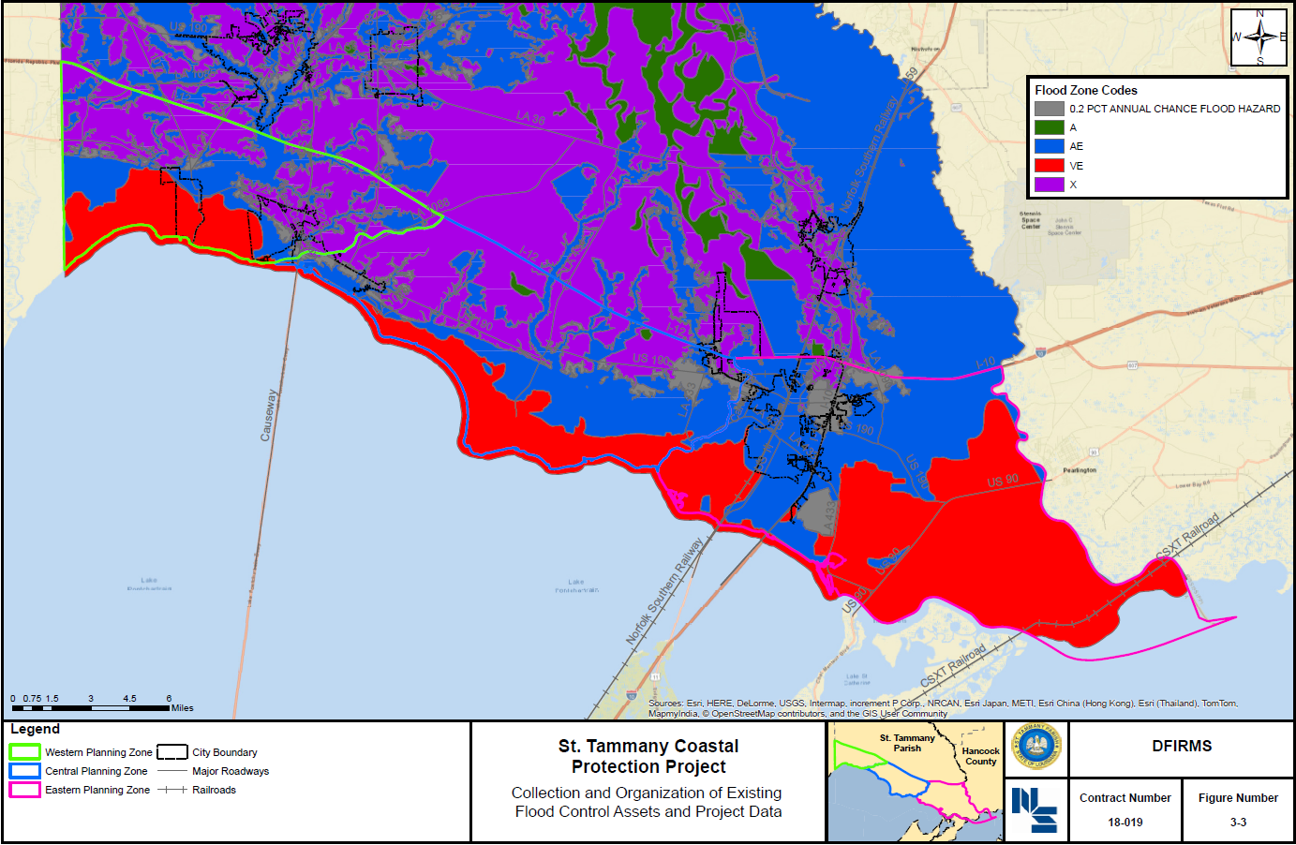
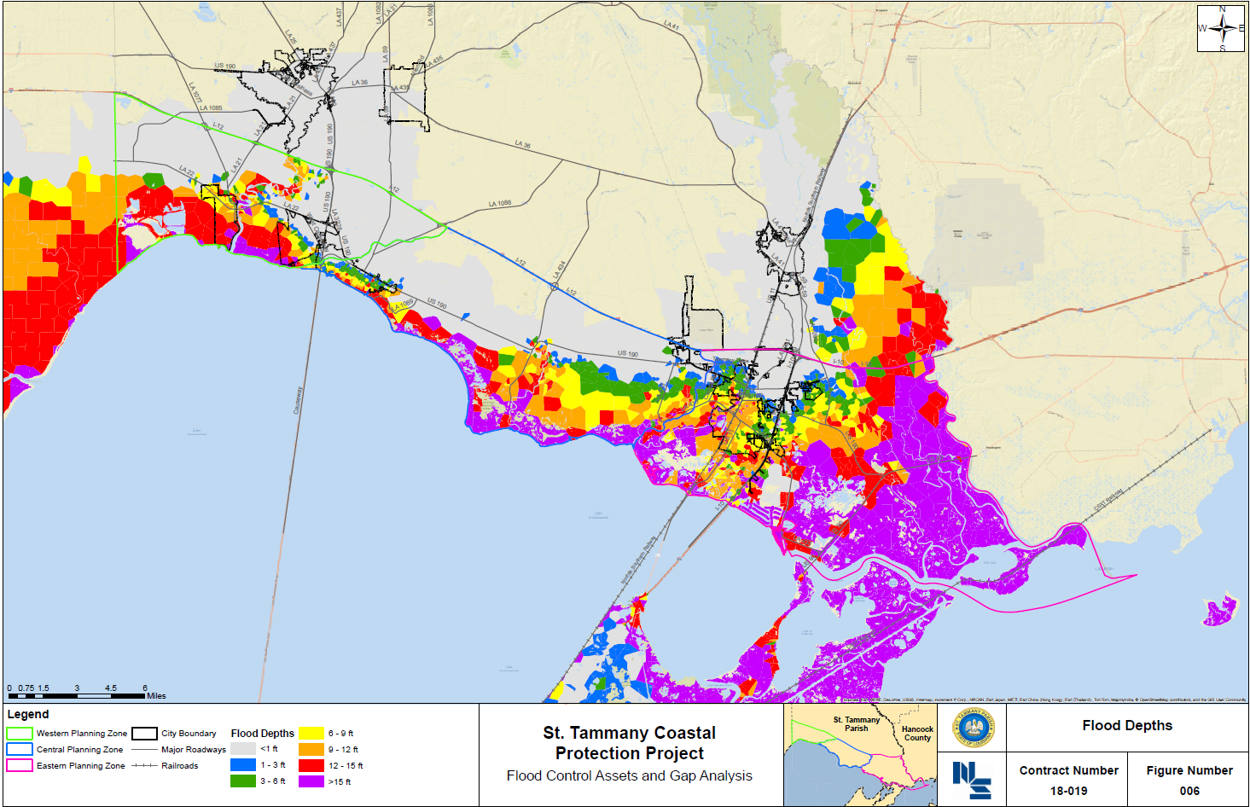
REPETITIVE LOSS
FIRMS
FLOOD RISK

Slide 9
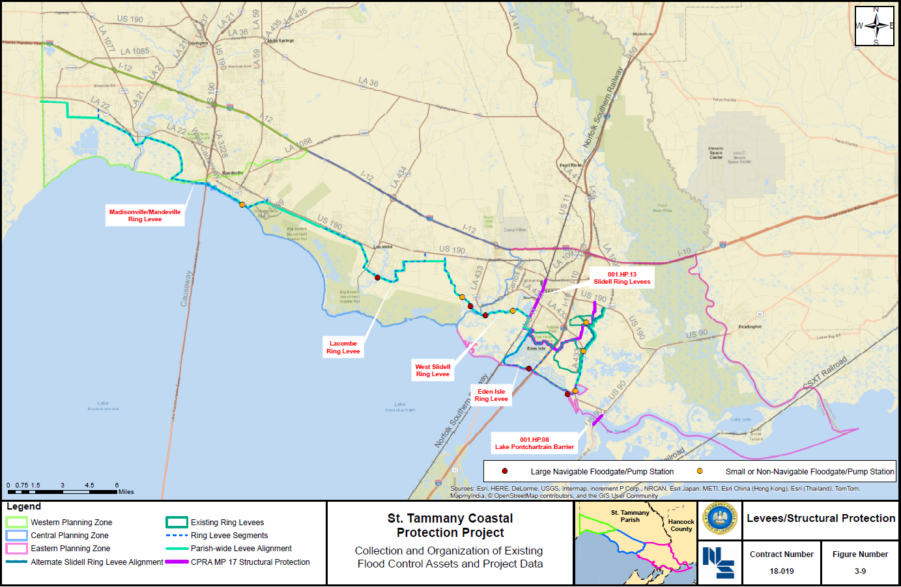
All Risk Reduction Alternatives Evaluated

Slide 10
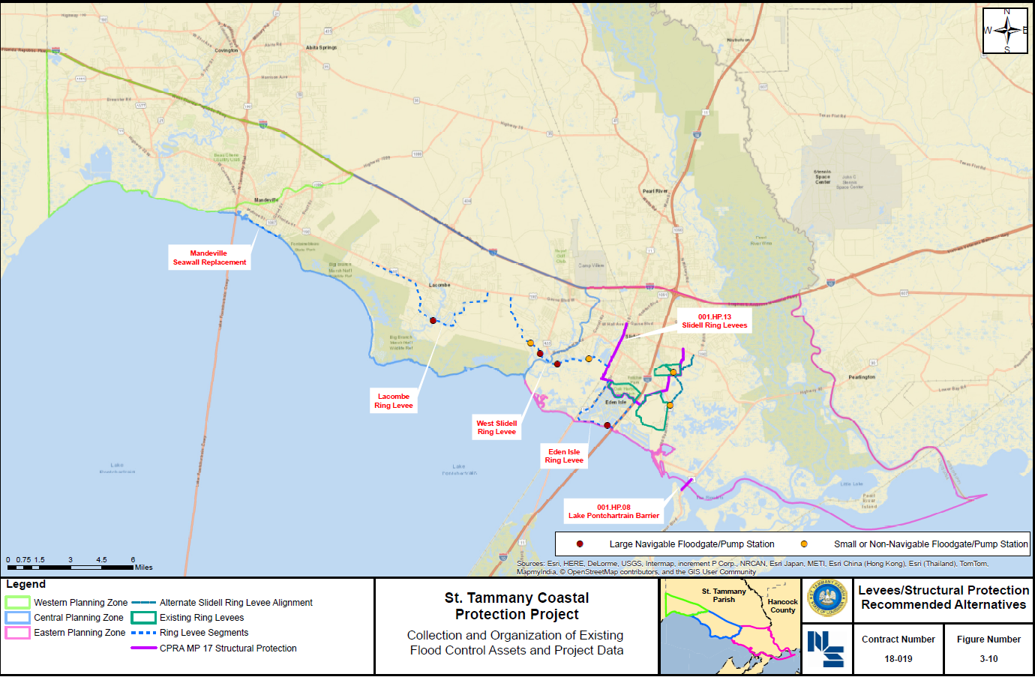
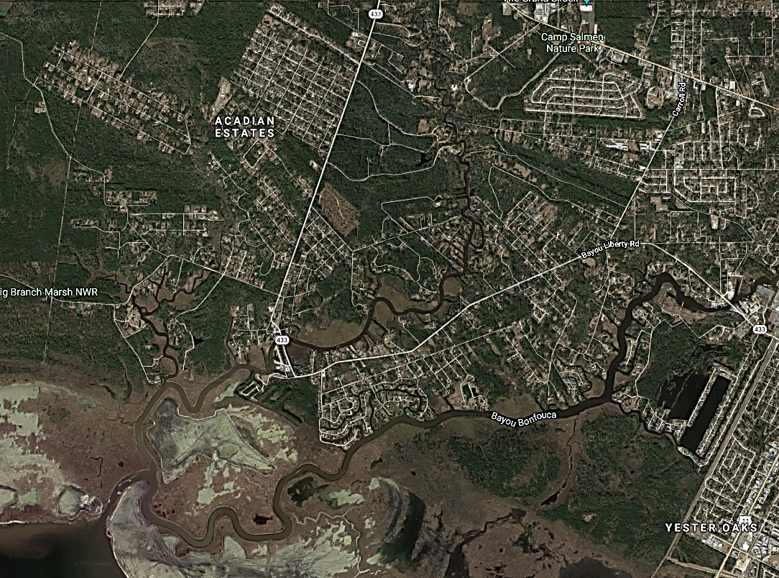
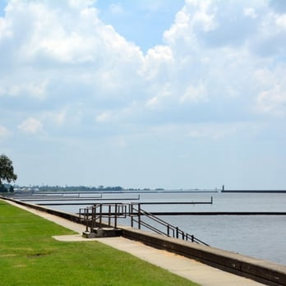
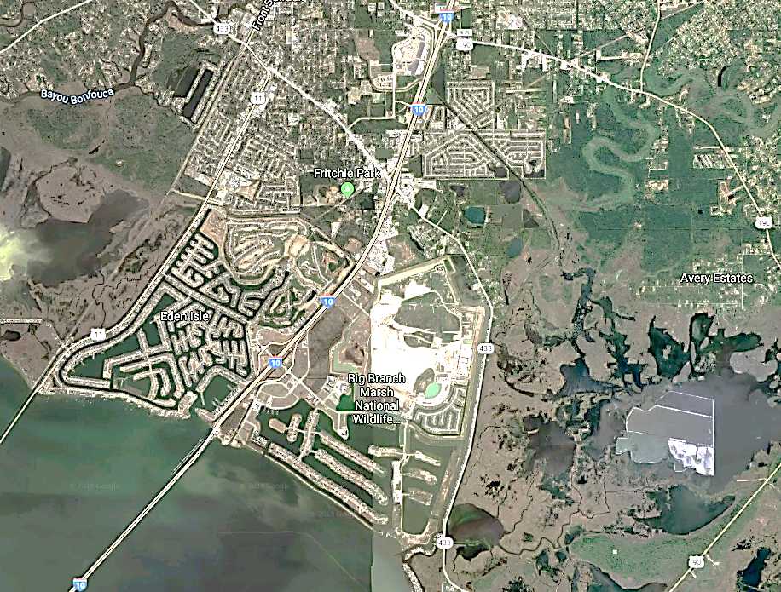
Proposed Risk Reduction Alternatives
Mandeville Lakefront Flood Risk Reduction
South Lacombe Levee
West Slidell Levee
Eden Isle Levee

Slide 11
RESTORATION & COASTAL RESILIENCE

Slide 12
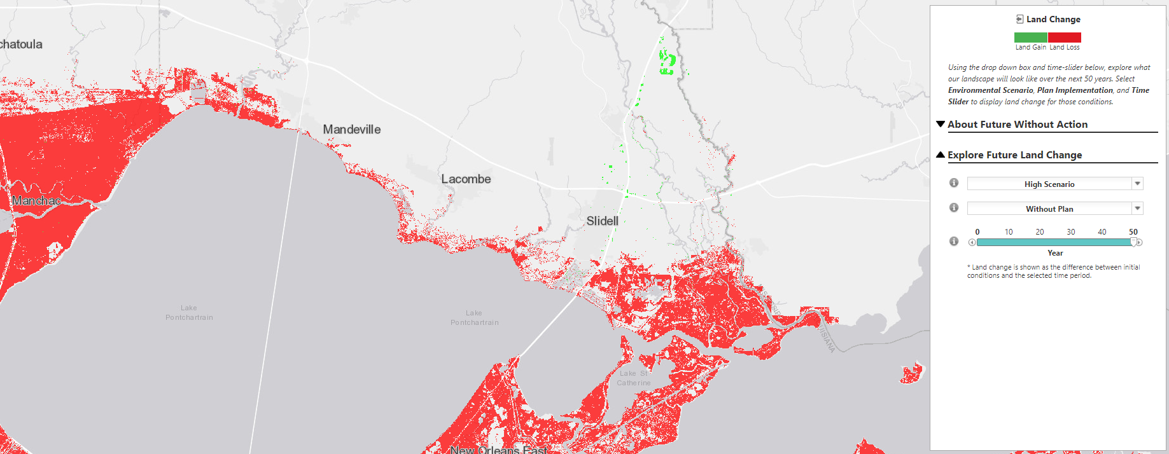
2017 CPRA Master Plan – Projected Land Loss
Notes:
Current Master Plan projects for St. Tammany. Whatever is finalized by the Parish, we want to make sure projects are consistent with the State’s Master Plan.
We note that there are currently no structural protection projects proposed for many areas of the Parish, and we will focus on this gap in protection. NS would look at structural alternatives throughout the parish.

Slide 13
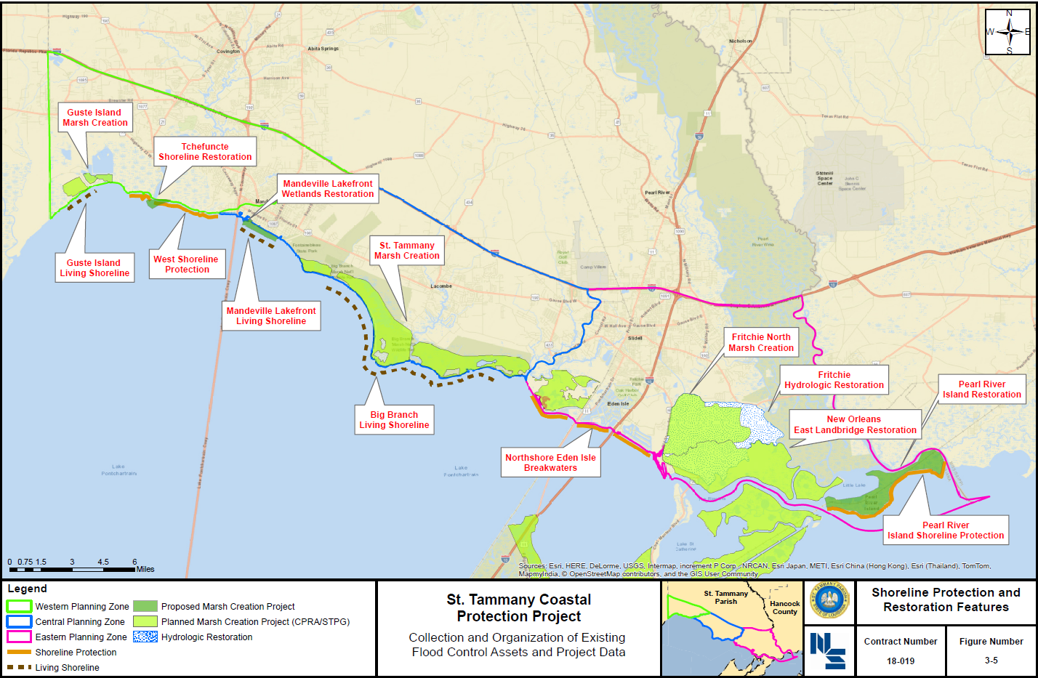
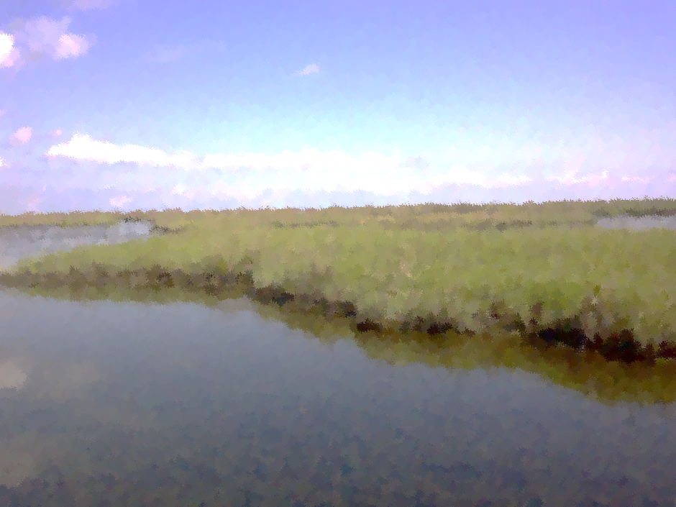
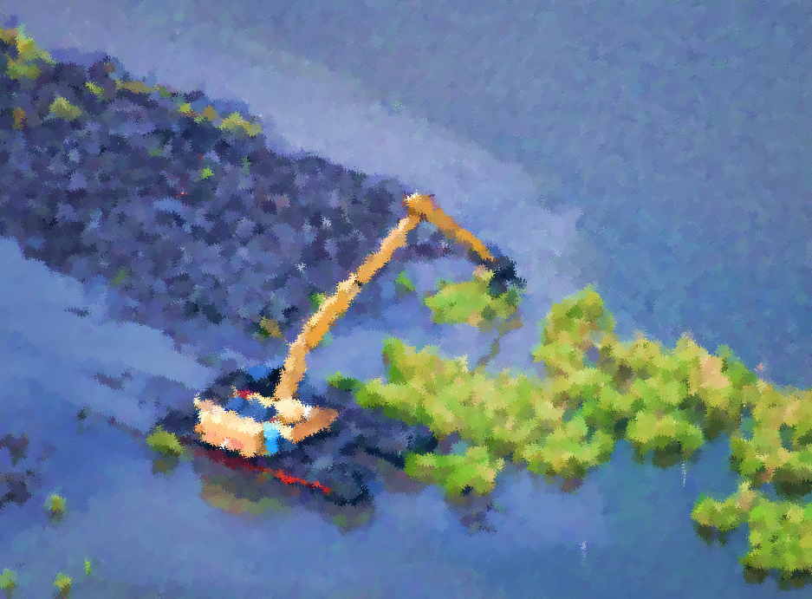
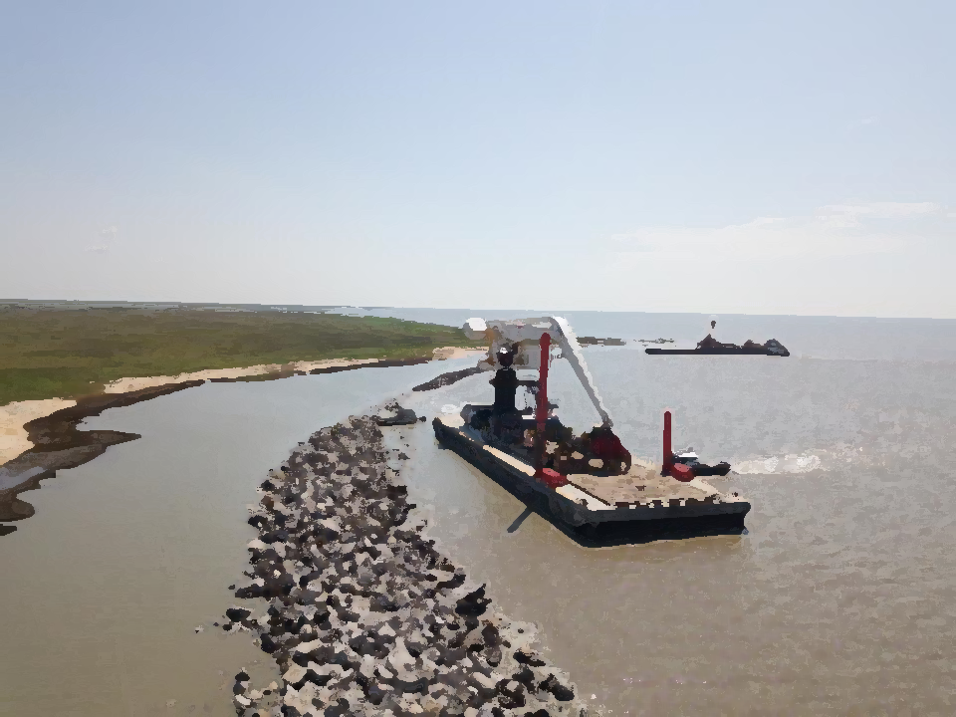
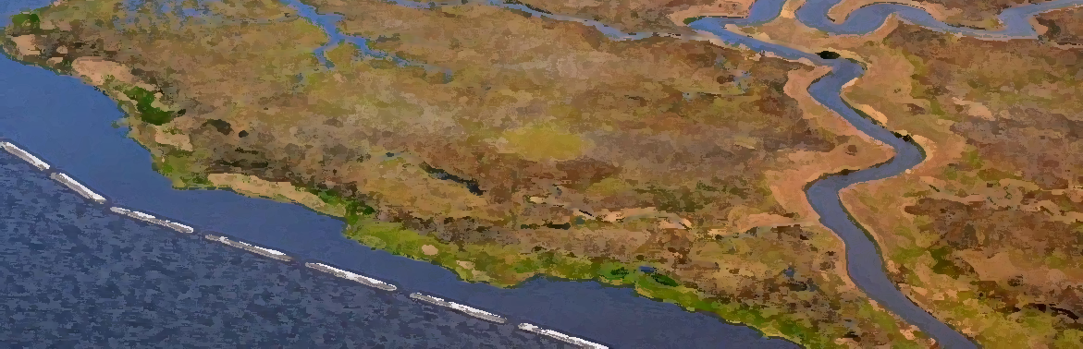
Proposed Restoration Projects

Slide 14
St. Tammany Parish Coastal Study Status

Slide 15
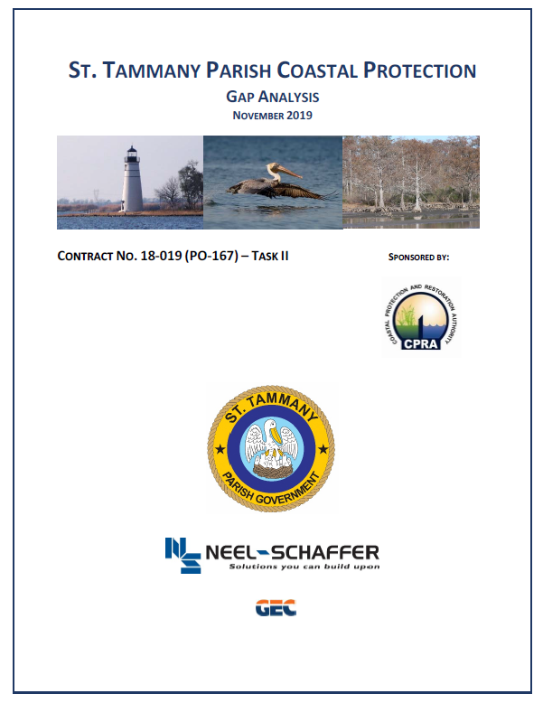
St. Tammany Parish Coastal Study Status
Phases of Study
Phase 1 – Collection & Organization of Flood Control Data
  COMPLETED
Phase 2 – Gap Analysis
  COMPLETED
Phase 3 – Project Feasibility Analysis & Engineering
  ONGOING
Notes:
Our team is local and has offices in Slidell and Mandeville.
A local presence ensures that our work is informed and coordinated with the issues, governance, and opportunities unique to St. Tammany Parish.

